Slide 1


SMART INDIA HACKATHON 2025
TITLE PAGE
Problem Statement ID – SIH 25041
Problem Statement Title- AI-Driven Unified Data Platform for Oceanographic, Fisheries, and Molecular Biodiversity Insights
Theme- Ocean Pulse AI
PS Category- Software
Team ID- SIH25-26
Team Name (Registered on portal) - Aquamind

Slide 2
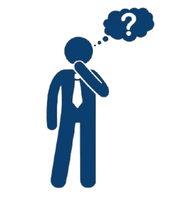



IDEA TITLE
AQUAMIND
Challenges
Data Fragmentation: Oceanographic, fisheries and molecular biology data stored in siloed systems.
Accessibility Issues: Lack of real-time visualization and advanced analytics for marine scientists and policymakers.
01
Proposed Solution
A centralized system to harmonize siloed datasets using AI/ML.
Provides real-time visualization and analytics.
Includes interactive dashboards with intuitive insights.
Value Proposition
Empowers marine scientists with unified, actionable data.
Supports policymakers in making informed, evidence-based decisions.
03
02
Uniqueness
Developed a proprietary, optimized database tailored for oceanographic biodiversity.
Leverages AI/ML algorithms to provide fast, accurate, and actionable insights.
04
Key Feature
Unified searchable database for multidisciplinary marine data.
Interactive dashboard with intuitive visuals and real-time insights.

Slide 3



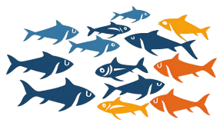
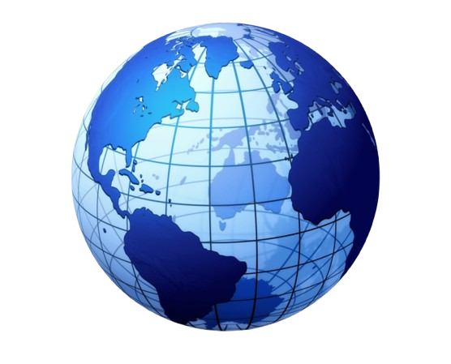

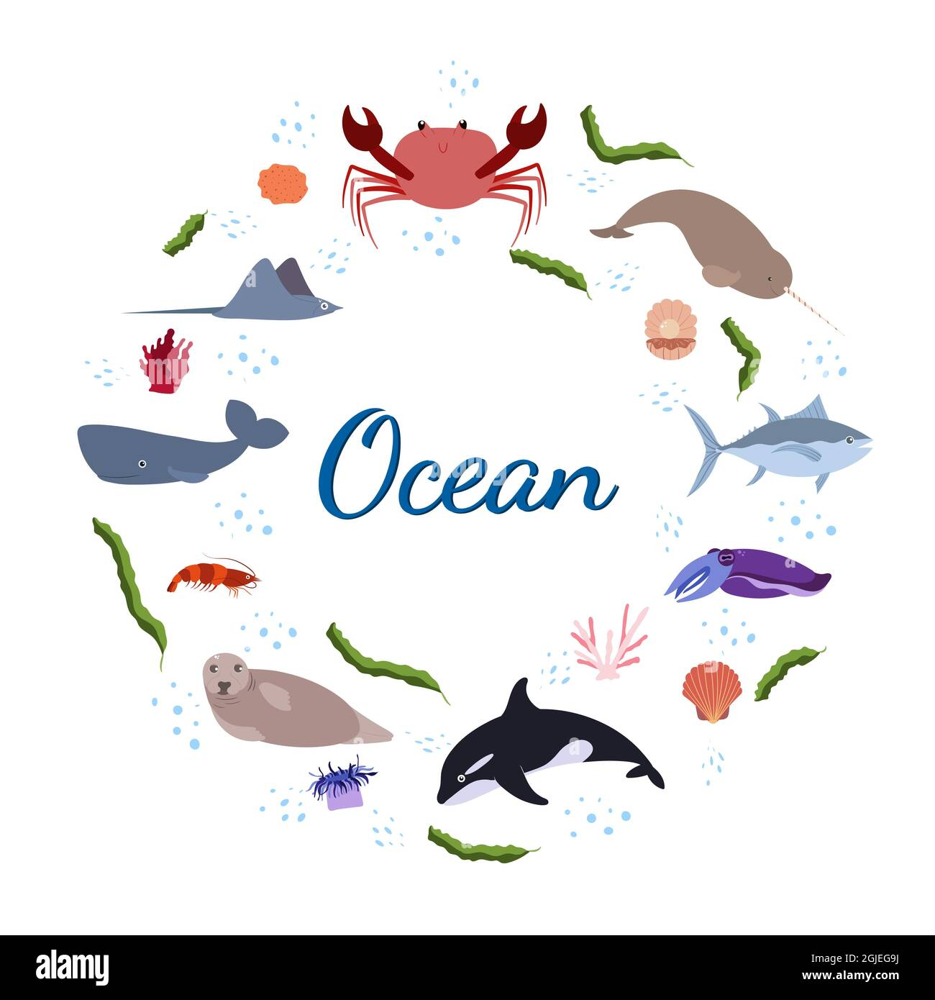
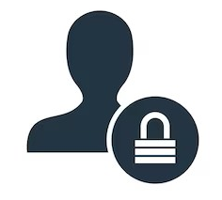

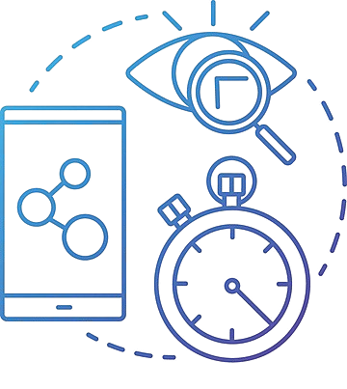



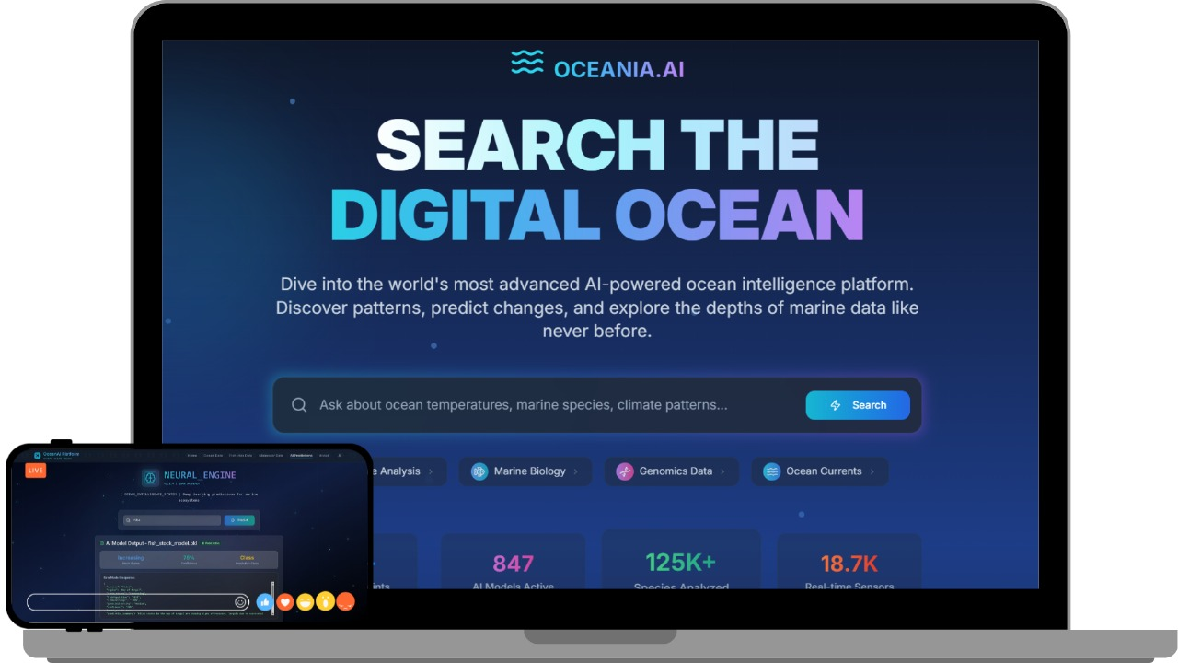

TECHNICAL APPROACH
AQUAMIND
Programming Language: Python : For developing and training ML models. JavaScript: Used for building dynamic web applications and integrating frontend with backend services. Frameworks and Libraries : React: For building frontend services. Node.js: For backend services. Leaflet.js: For creating interactive maps. Plotly.js: For creating charts and graphs. Matplotlib: A key tool for data visualization and exploration. Scikit-Learn: Used for training, testing, and evaluating the machine learning model. Supabase: For authentication and database storage.
Key Features of the OceanAI
Login
Ai-Predictions
Molecular data
DNA Sequence
Analysis
Genetic Diversity
Map
Species
Info
Authentication
Search bar
Real-Time
Updation
AI/ML
View Prototype Our product is 70% complete , now we are focused on gather updated data
cloud
Website Display
Demo Video

Slide 4
FEASIBILITY AND VIABILITY
AQUAMIND
Analysis of the feasibility of the idea
AI frameworks (e.g., TensorFlow, Supabase) enable robust large-scale data integration.
Scalable across CMLRE and other Indian marine institutions, with potential for national expansion.
Intuitive interface designed for marine scientists and policymakers.
Promotes sustainable marine management and benefits ecosystems.
Challenge 1
Sensitive government and research datasets raise security, ownership, and sharing concerns
Challenge 2
Limitations in real-time processing of unstructured data and AI accuracy across diverse sources.
Challenge 3
High storage and computing costs for large oceanographic datasets.
Cybersecurity & Data Privacy
Technology Limitations
Cost-Efficient Cloud Solution
Solution
Solution
Solution
Implemented end-to-end encryption and role-based access controls, ensuring 99% data security compliance with marine research standards
Integrated datasets from 4-5 authoritative sources (e.g., OBIS) and applied AI/ML algorithms to ensure 80%+ accuracy in real-time processing.
Deployed scalable cloud services with provider credits and compression techniques, reducing costs by 30% while ensuring data accessibility.

Slide 5
IMPACT AND BENEFITS
AQUAMIND
01
02
Enhanced Efficiency
Informed Decision-Making
Reduces data search and processing time, allowing researchers to focus on analysis.
India’s marine fisheries sector supports 14 million livelihoods; our platform can increase efficiency by 30%
Provides accessible , real-time insights for timely and effective policy interventions.
03
04
Global Collaboration
Stronger Conservation
Facilitates proactive strategies for protecting marine biodiversity and ecosystem.
Over 7,000 marine species in Indian waters need monitoring—AquaMind enables unified biodiversity tracking.
Fosters a collaborative environment , accelerating scientific discovery and shared solutions.

Slide 6
RESEARCH AND REFERENCES
AQUAMIND
Challenges faced:
Fragmentation and Incompatibility: Data collected from various sources – oceanographic sensors, fishing vessels, and molecular labs – uses diverse formats and lacks universal standards, making integration difficult. (https://share.google/Dxry7iPmVtXWhnAQW)
Enormous dataset sizes present management challenges for storage and interpretation.
Accessing and Collecting Marine Data: Reaching vast and remote ocean areas for sample collection requires expensive research expeditions, while microbes in marine environments are often highly dilute. (Link)
Existing Technology:
https://www.ncei.noaa.gov/products/world-ocean-database
https://www.fao.org/fishery/statistics-query/en/home
This site includes detailed statistics on fish production.

